Slide 1
Class room Session: Gamification
ACCOUNTING EDUCATION RESEARCH GROUP
Prof. Dr. Patricia Everaert
EAA Annual Conference, Helsinki - May 24th 2023
Notes:
Good afternoon everyone

Slide 2
Leasing
recap

Slide 3
How many differences?
Belgian GAAP | Operating Lease | Financial Lease
 | Off-balance | On-balance
 | No debt | Financial debt
 | No depreciation | Depreciation
 | No interest | Interest expense
 | Lease pay = expenses | Lease pay (capital) = debt decrease

Slide 4
Agenda
Game design elements (attributes, features)
Simple games to use as “intro” to class
Free education app from Ghent University: DUGA

Slide 5
Gamification is everywhere
“The use of game design elements in non-game context”

Slide 6
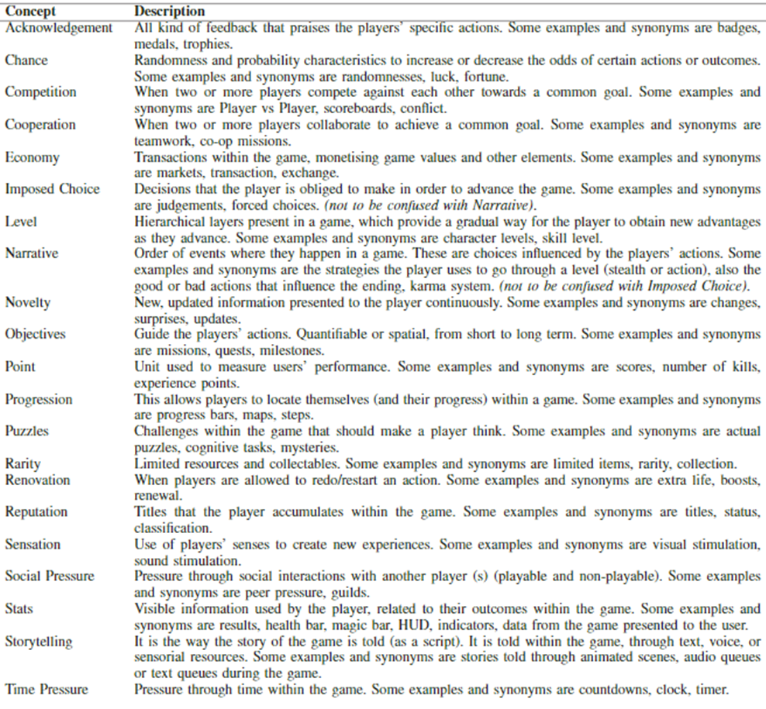

Slide 7
Taxonomy of game design elements (Toda et al., 2019)
Acknowledgement
Chance
Competition
Cooperation
Experience points
Novelty
Objective
Progression
Sensation: visual stimulation (sound stimulation)
Time pressure
Immediate feedback

Slide 8
Funny Games (funnygames.org)
Acknowledgement
Chance
Competition
Cooperation
Experience points
Novelty: surprising effect
Objective
Progression
Sensation: visual stimulation (sound stimulation)
Time pressure
Immediate feedback

Slide 10
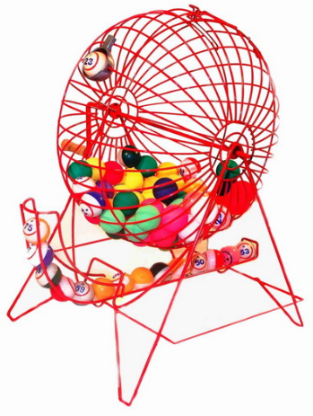
Bingo
Prof. Dr. Patricia Everaert
EAA Annual Conference, Helsinki - May 24th 2023
10
Notes:
To change questions: simply use the existing template
Use insert action to go to the appropriate slide (correct, false)

Slide 11
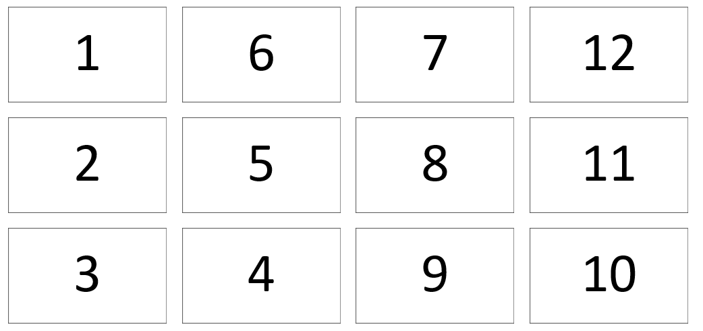
Start
Take a piece of paper
Make a matrix of 3 by 4
Write random: 1 to 12

Slide 12
Rules
Random number
Question
Correct answer: you get this coin! (circle the number)
Wrong answer: nothing lost
When all numbers on a row are circled: call “Bingo”

Slide 13
1
5
2
3
4
6
7
8
10
11
12
9

Slide 14
1. Management accounting analyses accounting data with the help of ______.
A
Auditor
B
Statutory forms
C
Tools and techniques

Slide 15
2. Managerial accounting information is generally prepared for ….?
A
Shareholders
B
Statutory forms
C
Managers
D
Regulatory agencies

Slide 16
3. Managerial accounting is designed for use by?
A
Internal users
B
Clients
C
External uses
D
Stockbrokers

Slide 17
4. Costs that do not vary with the volume of goods produced are called ….. costs?
A
Constant
B
Recurring
C
Fixed

Slide 18
5. Costs that do vary with the volume of goods produced are called ……. costs?
A
Indirect
B
Fixed
C
Variable

Slide 19
6. Costs incurred in the past are ….. costs
D
Sunk
B
Direct
A
Opportunity
C
Variable

Slide 20
7. The welcome reception yesterday was organized in …..
A
Dipoli
B
Tapiola
C
Wanha Satama

Slide 21
8. The capital of Finland is ……….?
A
Helsinki
C
Turku
D
Tallinn
B
Tampere

Slide 22
9. This year the EAA annual conference is organized in ….
A
Cyprus
B
Helsinki
C
Espoo

Slide 23
10. In 2023 (this year), the EAA is organized for the ….. th time?
A
25
B
35
C
45

Slide 24
11. From which university is the presenter?
A
Aalto
B
Glasgow
C
Ghent

Slide 25
12. Next year the EAA will be organized in ….?
A
Rome
B
Bucharest
C
Bergen
D
Cyprus

Slide 26
Congratulations: correct answer!

Slide 27
Oeps!!! Wrong answer!

Slide 28
Instructions for teachers
To go to appropriate question: click on the number in the ppt.
To see the answer: click one time with pointer
To go back to the board: click on this figure

Slide 30
BINGO
Acknowledgement: coins
Chance
Competition
Cooperation
Experience points
Novelty
Objective
Progression
Sensation: visual stimulation (sound stimulation)
Time pressure
Immediate feedback

Slide 31
DUGA
Prof. Dr. Patricia Everaert
EAA Annual Conference, Helsinki - May 24th 2023

Slide 32
DUGA
Why?
Gamification during class
To engage: “surprise”
Gamification outside of class
To practice
Teaser

Slide 33
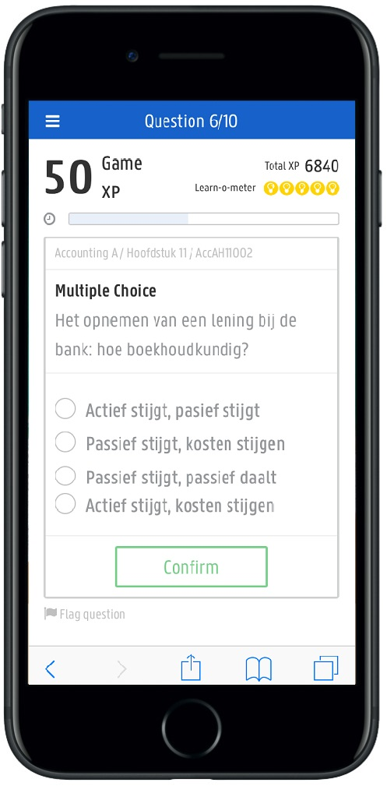
DUGA: Objectives
To practice
Independent
Outside of class
With immediate feedback
Anywhere, anytime
To challenge our “stronger” students
To motivate our “weaker” students
In a different way
Using technology and AI
And … fun!

Slide 34
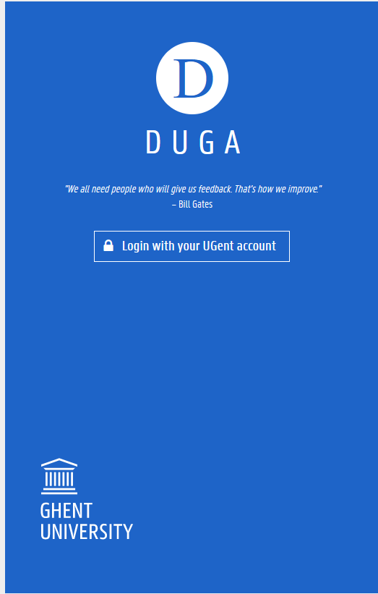
Fun …. Gamification
Badges
XP-points
Level: learn-o-meter
Nicknames
Leaderboards
Timing
Feedback
Notes:
Gamification = “The use of game design elements in a non-game context” (Deterding, Dixon, Khaled & Nackle, 2011)
Dit is een algemene slide, gewoon om aan te geven dat we in de volgende slides, op de verschillende gamified elements terugkomen.
Dat er voor verschillende cursussen kan gewerkt worden, zou ik hier niet vermelden.

Slide 35
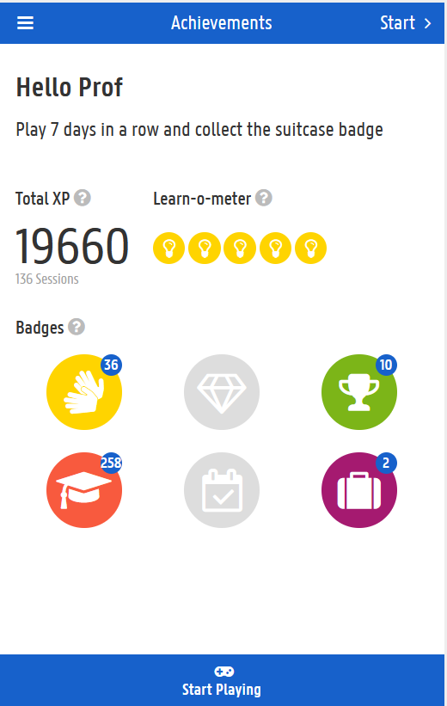
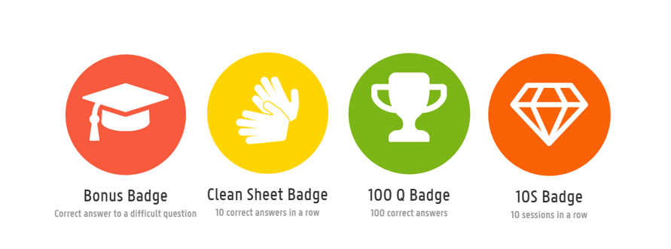
Gamification
Badges
XP-points
Level: learn-o-meter
Notes:
Keep track of progress:
By badges
By xp points: 10 points for a correct question

Slide 36
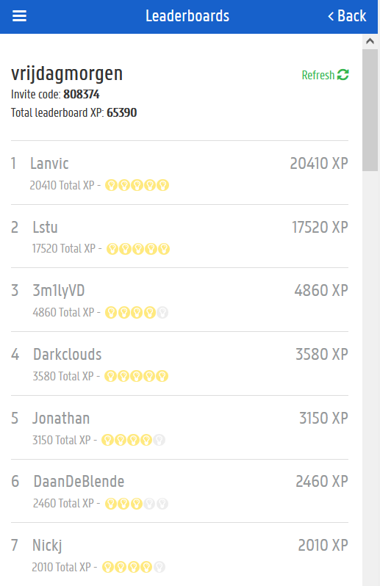
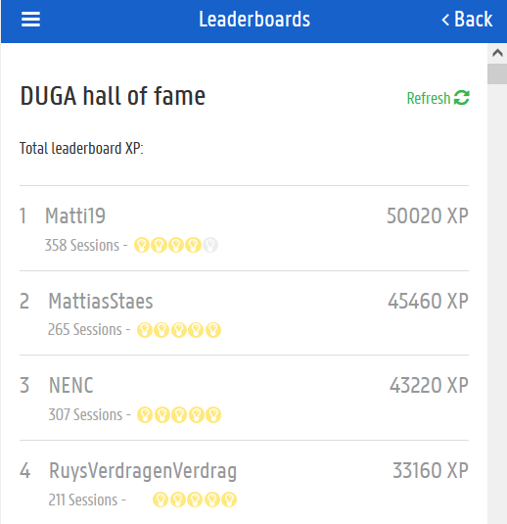
Gamification
Nicknames
Leaderboards
Notes:
Nicknames: e.g. darkclouds
Leaderboard: left: hall of fame; middle: leaderboard for one class
Challenges: right: students challenges another student

Slide 37
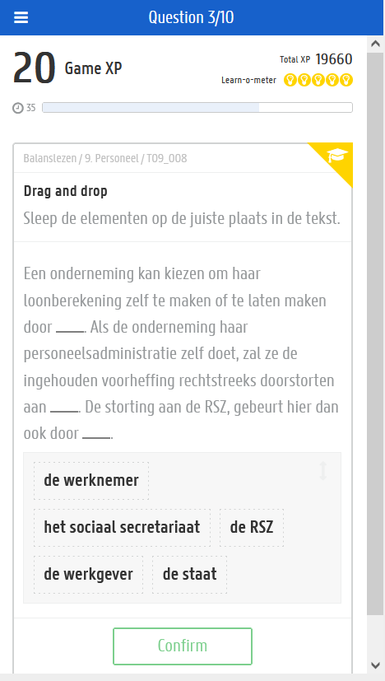
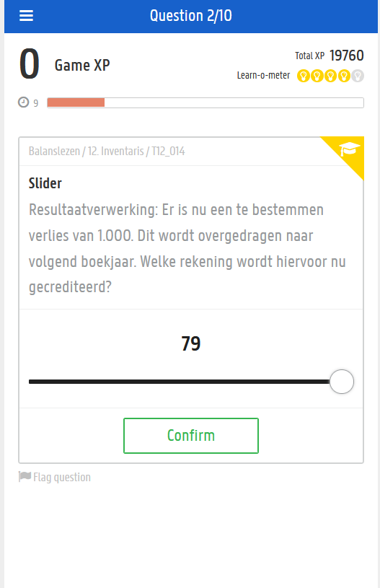
Gamification
Timing
Notes:
Chance = randomness => to create randomness, luck, fortune

Slide 38
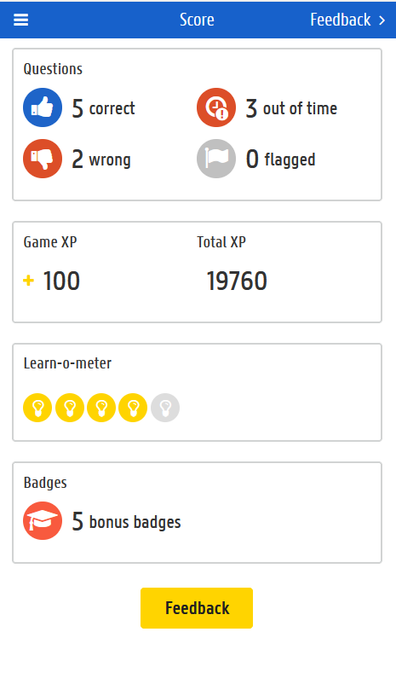
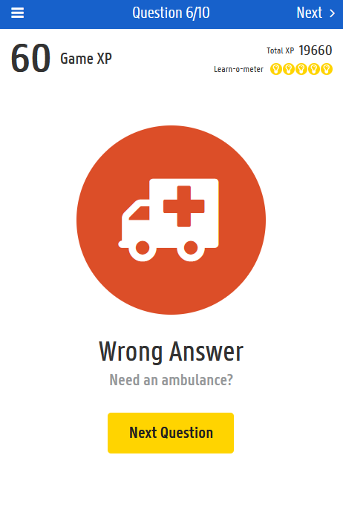
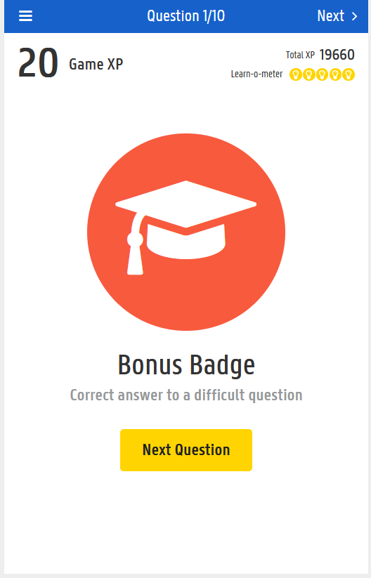
Gamification
Feedback: immediate after each question

Slide 39
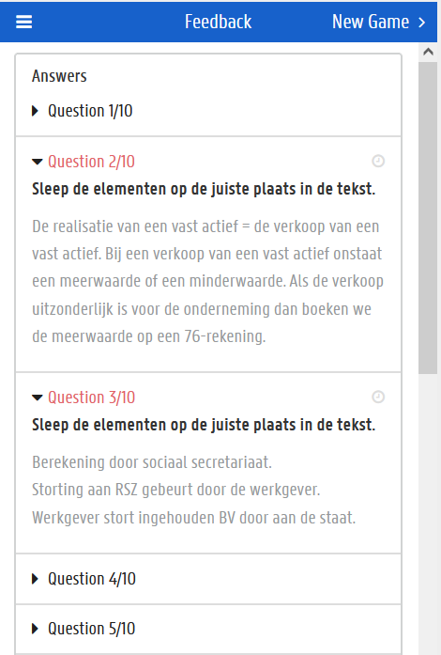
Gamification
Feedback: on content as well

Slide 40
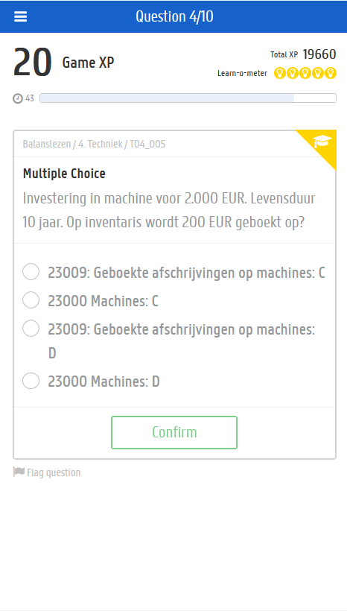
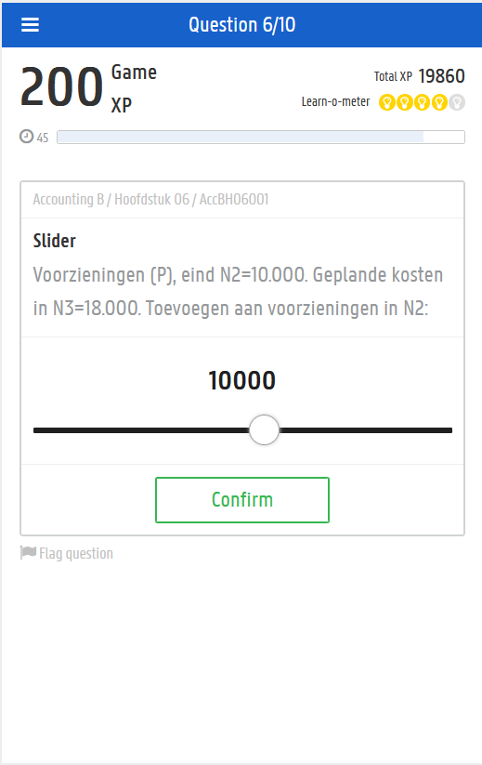
Quiz with different formats
Multiple choice
Slider
Order
Syllables
True, false
Outcome (picture)

Slide 41
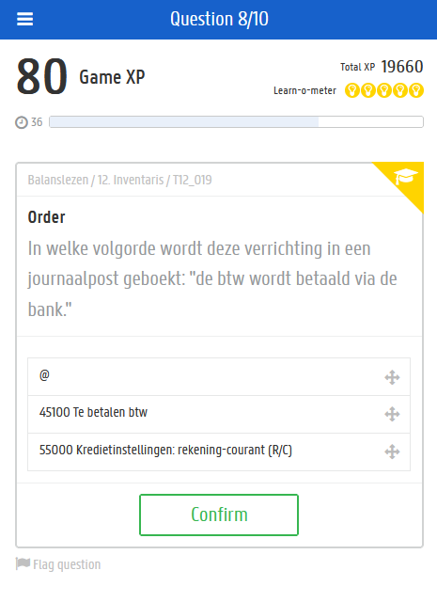
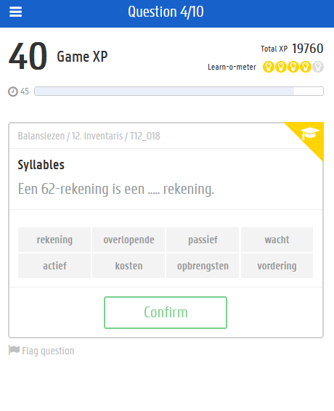
Quiz with different formats
Multiple choice
Slider
Order
Syllables
True, false
Outcome (picture)

Slide 42
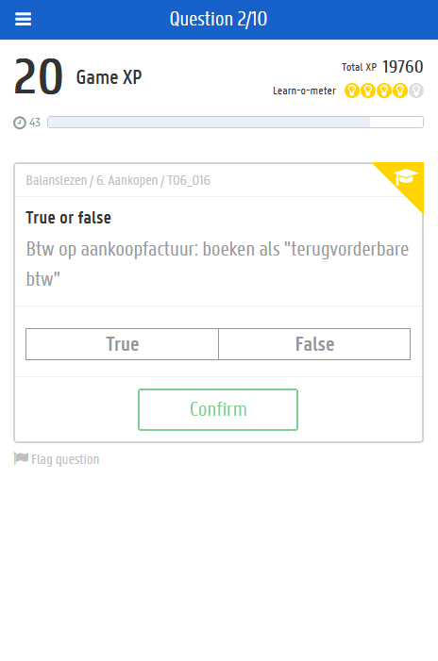
Quiz with different formats
Multiple choice
Slider
Order
Syllables
True, false
Outcome (picture)

Slide 43
In sum:
Gamification
Immediate feedback
But also:
Smart Picking
PC or smartphone
For the teacher:
Back-end: user friendly
Starting from small database of questions
Adapting questions
Adding questions
…

Slide 45
Try it yourself
1. Playing the role as “student” on your phone in my class:
E.g. use your hotmail email to register
2. Playing the role as “teacher” on laptop for your own class:
E.g. use your university email to register

Slide 46
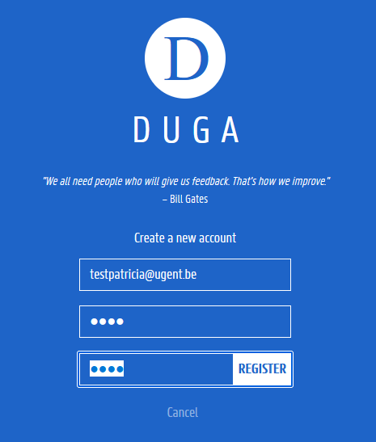
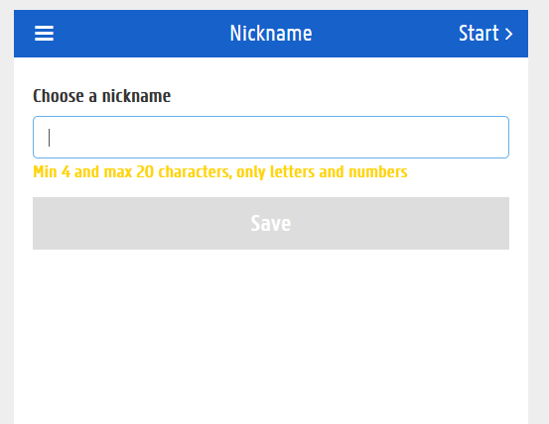
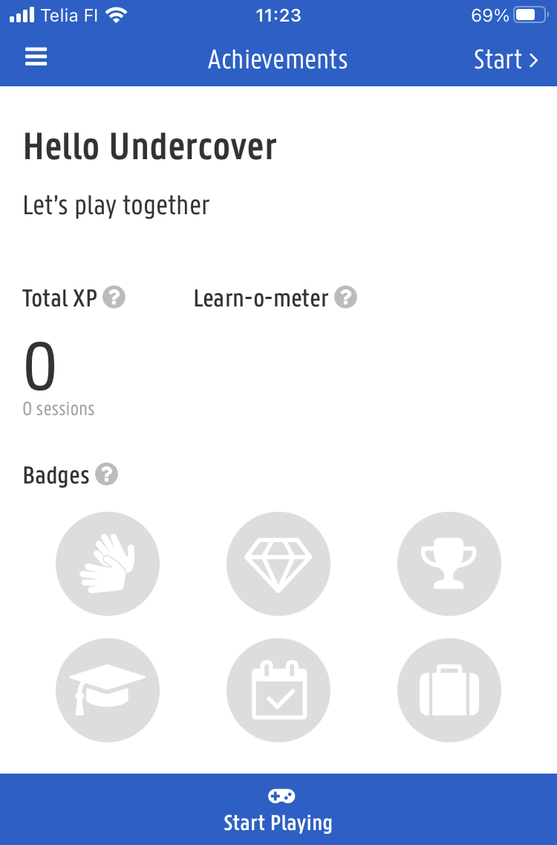
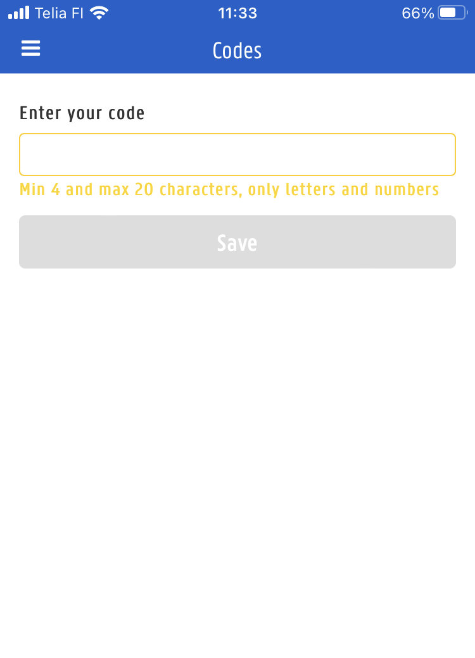
Duga.castars.net
Step 1:
Register as “student”: e.g. hotmail address
Password: e.g. Helsinki2023!
Nickname
Step 2:
Start playing
Add new course
Enter code
Step 3: Intro to Accounting
5 9 0 d e 1

Slide 47
DUGA
Acknowledgement: badges
Chance: random questions, smart picking (within schedule)
Competition: leaderboard
Cooperation
Experience points: XP points
Novelty: surprises
Objective
Progression: X of the 10 questions
Sensation: visual stimulation (sound stimulation)
Time pressure: counting down (adaptable)
Immediate feedback: instant + content after 10 Q

Slide 49
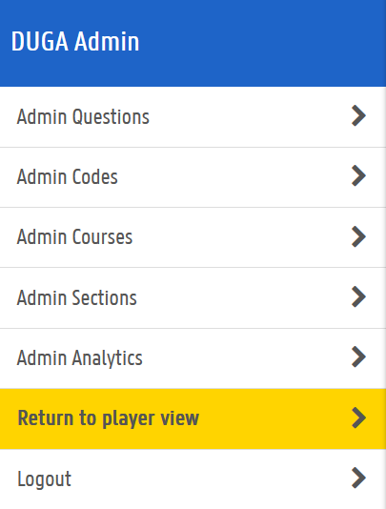
Back end
Take the role as teacher

Slide 50
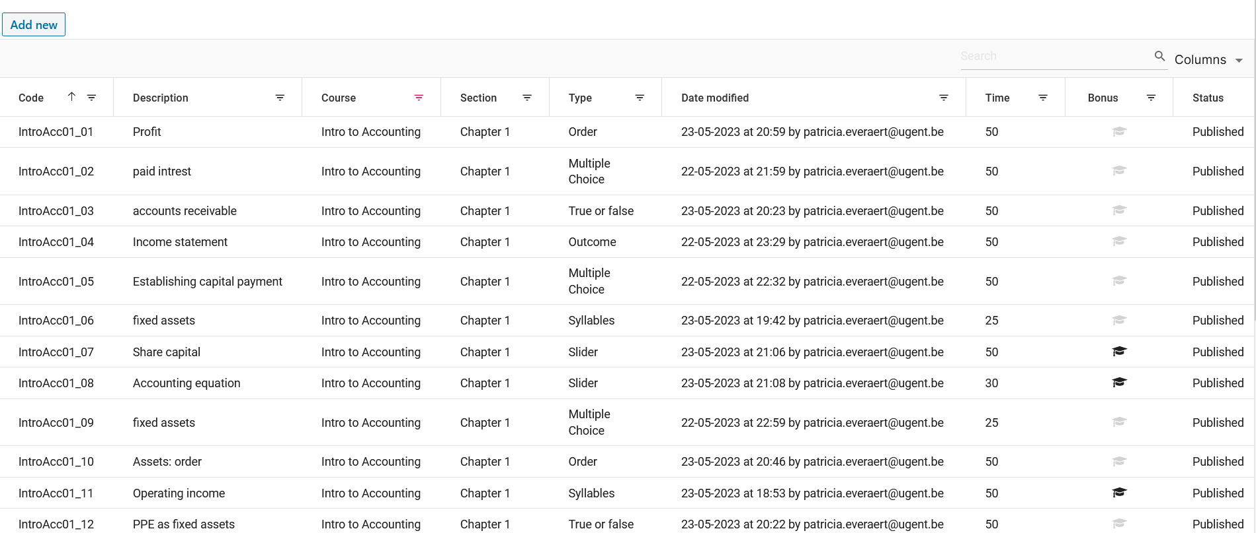
Admin questions

Slide 51
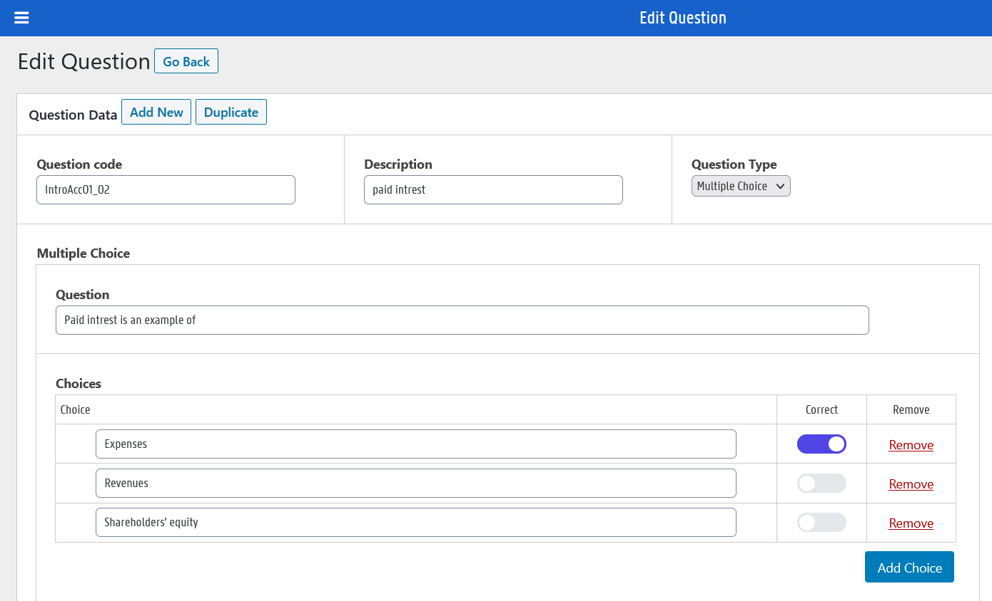
Edit Question

Slide 52
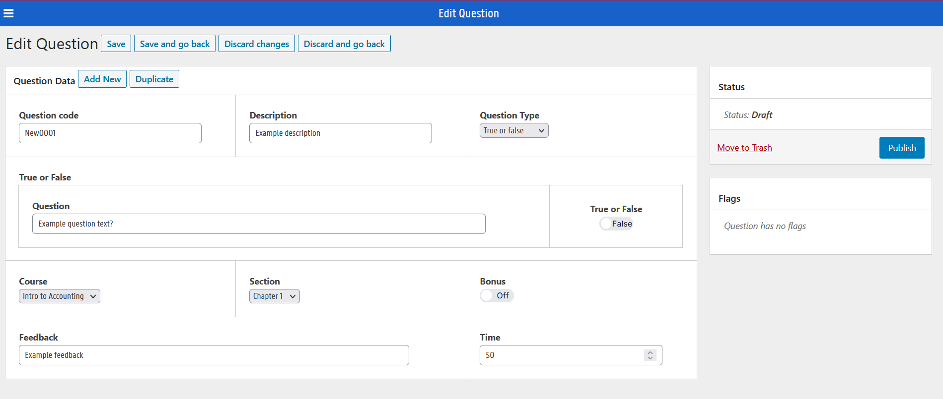
New question

Slide 53
Admin sections: to schedule
Schedule chapter 1 + 2

Slide 54
Admin analytics

Slide 55
Admin codes: to generate code for your students

Slide 56
Try it yourself
1. Playing the role as “student” on your phone in my class:
E.g. use your hotmail email to register
2. Playing the role as “teacher” on laptop for your own class:
E.g. use your university email to register

Slide 57
Duga.castars.net
On laptop
Step 1:
Register as “teacher”: e.g. university address
Password: e.g. Helsinki2023!
Nickname
Step 2:
Start playing
Add new course
Enter code:
personal
Step 3: Intro to Accounting
*******

Slide 59
Teacher | Code
1 | a f a f 0 1
2 | b 1 5 5 7 4
3 | 7 f d e 6 b
4 | c 4 9 1 a 0
5 | 9 c a 2 a 8
6 | e a f 5 f 6
7 | 9 9 5 5 a 8
8 | 4 d 5 f 6 a
9 | 2 1 1 0 4 1
10 | a 2 1 4 c 9
11 | 1 8 9 9 5 9
12 | 2 6 4 5 8 d
13 | 1 7 3 9 8 4
14 | 1 b 6 8 2 d
15 | 2 1 b c 7 1

Slide 60
Teachers = admin
More options:
Admin questions:
E.g. Change a question
Admin codes:
To give to your students

Slide 62
How to use DUGA?
First time: use it in class, and play together
Use it as a competition: “beat the professor”
…
Students heavily use it before a mid-term exam or before the final exam
Students also like to use it for the re-sit exam, to review the material in another way.

Slide 63
Does it work?

Slide 64
2nd Undergraduate: intro course
ANCOVA on exam performance
Source | Sum of Squares | Df | Mean Square | F | Sig.
Gender | 49.695 | 1 | 49.695 | 4.261 | 0.040
Players | 147.194 | 1 | 147.194 | 12.620 | <0.001
Error | 3417.555 | 293 | 11.664
 | N | Exam
Non-player | 190 | 12.40
Player | 106 | 13.88

Slide 65
2nd Undergraduate: intro course
 | DV= Exam performance
 | Coefficient | p-value
Gender | 0.091 | 0.889
Intensity | 0.281 | 0.451
N | 105
 | DV= Exam
 | Coefficient | p-value
Gender | 0.329 | 0.598
Accuracy | 5.924 | 0.002
N | 106
Adj. R² | 0.076
F-test | 5.311
P-value | 0.006

Slide 66
1st Undergraduate: Financial Accounting
ANCOVA on exam performance
Source | Sum of Squares | Df | Mean Square | F | Sig.
Gender | 5.630 | 1 | 5.630 | 0.634 | 0.426
Year | 218.493 | 1 | 218.493 | 24.586 | <0.001
Ability | 12828.684 | 1 | 12828.684 | 1443.544 | <0.001
Player | 110.422 | 1 | 110.422 | 12.425 | <0.001
Error | 8362.608 | 941 | 8.887
 | N | Exam
Non- Player | 635 | 10.80
Player | 311 | 11.55

Slide 67
In sum
Use gamification elements during your classes!
Slides are on our website:
www.accountingeducation.ugent.be
Explore the app as student with code 590de1
If you want a teacher code to use the app with your students, leave your card with me!

Slide 68
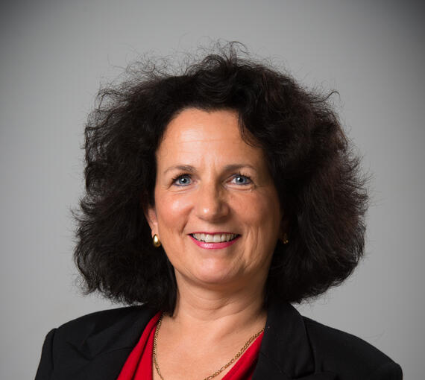
Patricia Everaert Full Professor Research group Accounting Education, Ghent University Patricia.Everaert@UGent.Be linkedin.com/in/patricia-everaert
Let’s stay connected!
www.accountingeducation.ugent.be
Notes:
We hope to have inspired you all and we would love to hear your feedback!

